Slide 1
Note Taking and Time Management Skills
College Prep
Mr. Gordon
jgordon@bisdtx.org

Slide 2
Upcoming Events
hi

Slide 3
Time Management
Many students struggle with time management.
Between CRCA and ACC classes, participating in clubs and organizations, spending time with friends and family, and self-care,
it can be hard to find time to accomplish everything.
Here are some tips to manage your time and hopefully make your life less stressful.
Time management is a skill that you will always be refining and improving at, even as an adult.
hi

Slide 4
Time Management
Using a day planner is one of the best ideas for organizing your life and responsibilities. I recommend using a paper planner instead of just a digital one, since this allows you to see what is coming up in the following days, weeks, and months. You can add upcoming papers and exams, but also schedule time with friends and events.
Free day planners can be found in the library.
Planning ahead and starting early are the best ways to lower stress, and a day planner is a good place to start. Be sure to look at it every day.
hi

Slide 5
Time Management
2. Prioritize your time. Consider which assignments and deadlines to focus on and start those early.
Also, if there are simple assignments, get those done first, so you feel accomplished and can mark them off your to-do list.
3. Get help. If you are struggling with time management or on a certain assignment, find a friend, teacher, or a tutor at the ACC Learning Lab to help you out and keep you on task.
hi

Slide 6
Time Management
4. Always remember to take care of yourself and do something to destress everyday.
This will help your physical, emotional, and mental health.
hi

Slide 7
Note Taking
Note taking during class can be frustrating for many students, especially when the professor is going quick.
But note taking is important and can greatly improve your grades.
Here’s how:
Helps you stay awake and focused during class.
Helps you learn the material and makes it easier to study when there is a test.
Is a skill that can be used later in college or in your career
Can assist others when they are absent from class
hi

Slide 8
Note Taking
Will you use a notebook or your laptop?
Either works as long as your laptop is not also a distraction.
Keep organized by assigning different notebooks or folders in your Google Drive for each subject.
What is frustrating about note taking is when you get behind. Don’t try to write down every word the professor says,
understand the big picture and stick to the important
facts and concepts.
hi

Slide 9
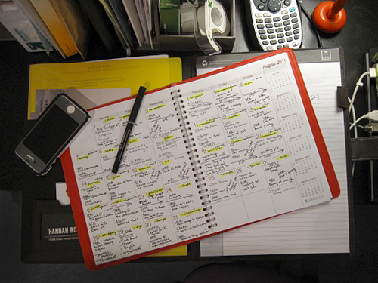
Assignment
Take out your day planner and plan out the rest of the week.
Answer the following question in the comments section:
What is the date for your grade’s Parent Meeting?
hi

